Slide 1
Once bitten, twice shy: modeling trade-offs between mosquito biting persistence and vertebrate host defensive behaviors
Kyle Dahlin
Virginia Tech
Department of Mathematics
JMM 2024
San Francisco CA

Slide 2
Despite empirical evidence of its importance to mosquito feeding success,
epidemiological models of mosquito biting have largely ignored the effects of host defensive behaviors on mosquito blood-feeding and pathogen transmission.
For example, it is known that vertebrate host defensive behaviors can increase opportunities for transmission by inducing multiple-blood feeding in mosquitoes. On the other hand, defensiveness can also lead to mortality in mosquitoes, which in turn might reduce transmission. These trade-offs have likely led mosquito species to follow one of two broad behavioral strategies in response to host behavioral defenses. While some mosquitoes will fly away at the first sign of host defensive behavior (leading them to make contact with multiple hosts), more persistent species will remain attached to their host until their blood meal is finished (thereby risking their death due to host defenses). Meanwhile, engaging in defensive behavior also comes at a cost to hosts. Many animals, especially large ungulates, tolerate biting from mosquitoes whereas smaller mammals like rodents will very actively defend themselves against biting.
Here, we investigate the implications of these trade-offs for mosquito-borne pathogen transmission using systems of ordinary differential equations. We consider different models of how hosts engage in behavioral defenses against biting and models of mosquito responses to such behaviors. By evaluating their basic reproduction numbers, we measure the transmission potential of systems of mosquito, host, and parasite populations across a range of levels of mosquito biting persistence and host defensiveness.
We seek to answer questions such as:
Are less defensive hosts more likely to be reservoirs for mosquito-borne pathogens? and
Are more persistent mosquito species more effective vectors of pathogens?
This presentation is a preliminary report.

Slide 3
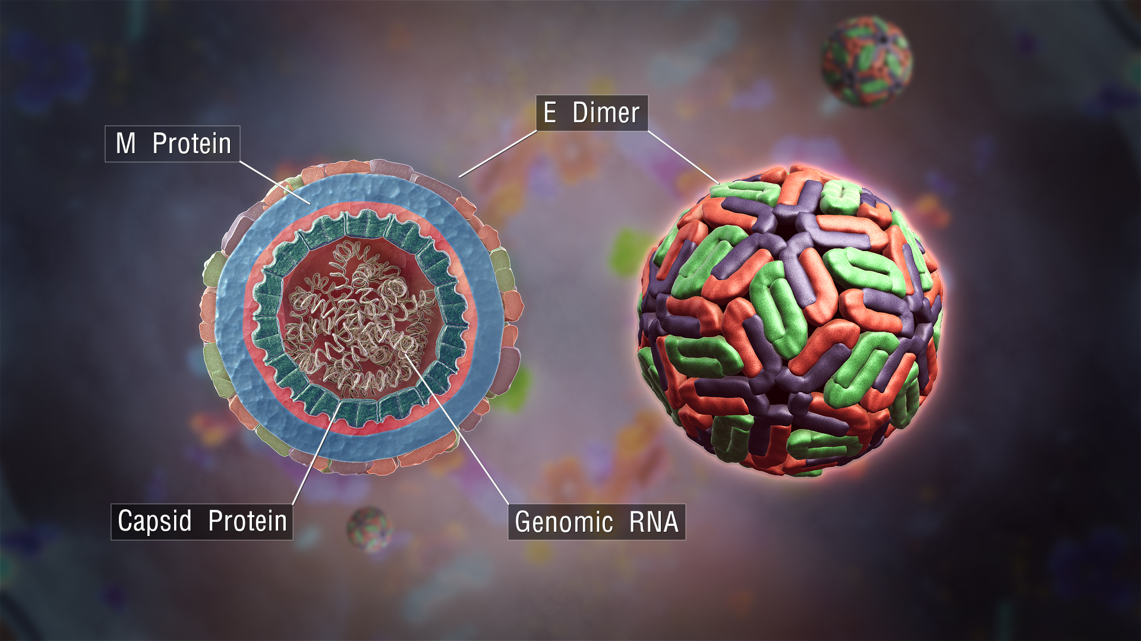
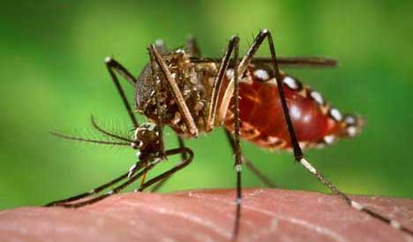
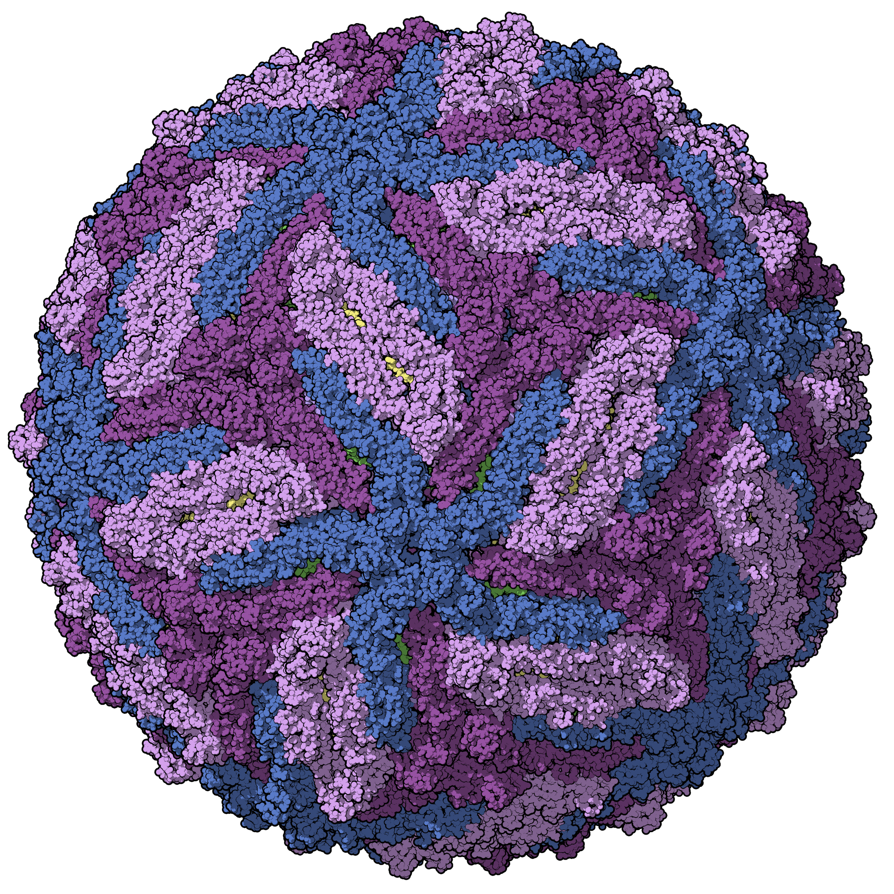
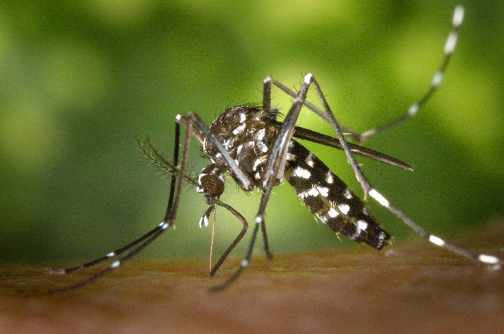
Mosquito-borne disease
>25% recent EID events were due to mosquito-borne zoonotic pathogens (Jones 2008, Gould 2017)
E.g. Dengue, Zika, Chikungunya
Direct contact with the wildlife host is not required for transmission → Vector-borne pathogens spread more readily to human populations compared to other zoonoses
Predicting spillover of mosquito-borne zoonotic requires accounting for:
the ecology of multiple hosts,
the life history of the insect vectors, and
the traits of the pathogens themselves
Aedes aegypti (CDC.gov)
Dengue virus virion (ScientificAnimations.com)
Zika virus virion
(Manuel Almagro Rivas)
Aedes albopictus (CDC.gov)

Slide 4
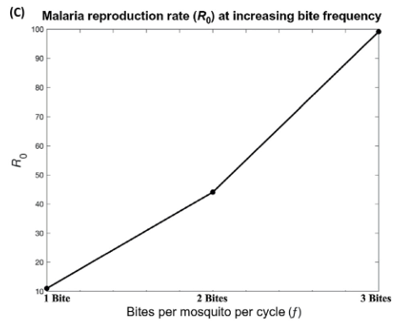
Multiple blood feeding – why it matters
More feeding attempts
More contact with hosts
More opportunities for disease transmission
Tedrow, R. E., P. A. Zimmerman, and K. C. Abbott. 2019. Multiple Blood Feeding: A Force Multiplier for Transmission. Trends in parasitology 35:949–952.

Slide 5
Multiple blood feeding – how it works
Feeding may be interrupted by host defensive behaviors like shaking, slapping, swatting, grooming, running, hiding, …
Mosquitoes may derive a fitness advantage from feeding from multiple sources
e.g. fecundity may be increased (Scott & Takken 2012)
Why don’t mosquitoes just feed as much as they want?
Feeding-associated mortality can be high (Briegel & Hörler 1993)
Are you more likely to notice a mosquito biting you for a longer time? Or one that keeps coming back for seconds?

Slide 6
Variation in multiple blood feeding among mosquito species
Show that there is variation among species
Characterize the variations
Individual variation
Contend with why these differences may have arisen
Eco-evolutionary forces

Slide 7
Multiple blood feeding – previous models

Slide 8
Multiple blood feeding & transmission
Identifying animal reservoirs of mosquito-borne zoonoses:
Are less defensive animals more likely to be reservoirs for mosquito-borne pathogens?
Assessing the disease risk of invasive mosquito species
Are persistent biting mosquito species more effective vectors of pathogens?

Slide 9
Mosquito blood feeding as a Poisson process
R
mortality
mortality
Blood-feeding
Resting, ovipositing, sugar-feeding
recruitment
H
H is the dwell-time distribution describing the time spent blood-feeding before moving to the other stage
R similarly describes the time spent resting,…, before returning to blood-feeding
The process can be represented as a system of distributed delay equations, but they are hard to work with…

Slide 10
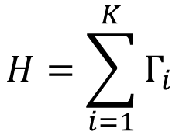
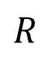
Mosquito blood feeding as a Poisson process
$$R$$
mortality
mortality
Blood-feeding
Resting, ovipositing, sugar-feeding
recruitment
$$H=\sum_{i=1}^{K}{Γ_{i}}$$

Slide 11
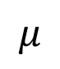
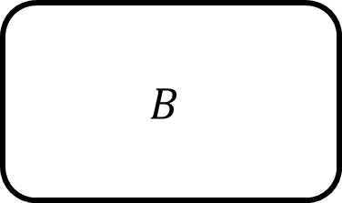
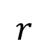
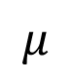
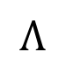
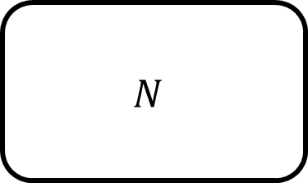
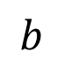
If $H \sim \text{Exponential}\left(\frac{1}{γ}\right)$, then we can use the memoryless property to write this as a simple system of ODEs
$$r$$
$$μ$$
$$μ$$
$$Λ$$
$$B$$
$$N$$
$$b$$

Slide 12
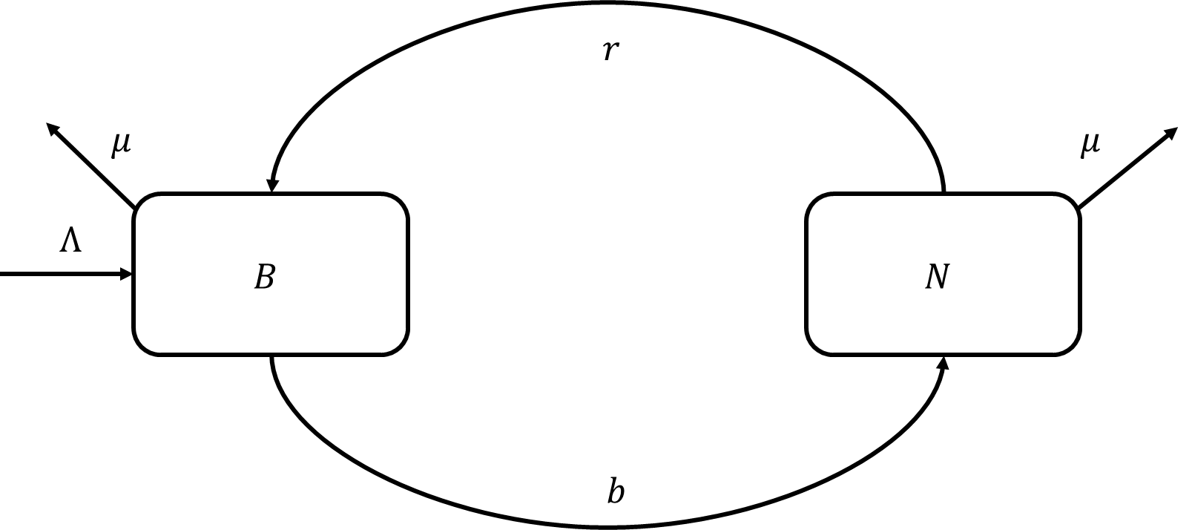
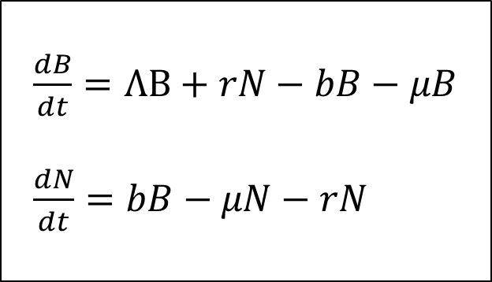
But if all the distributions are exponential, i.e. $H \sim \text{Exponential}\left(\frac{1}{b}\right)$, then we can use the memoryless property to write this as a simple system of ODEs:
$\frac{dB}{dt}=ΛB+rN−bB−μB$
$\frac{dN}{dt}=bB−μN−rN$

Slide 13
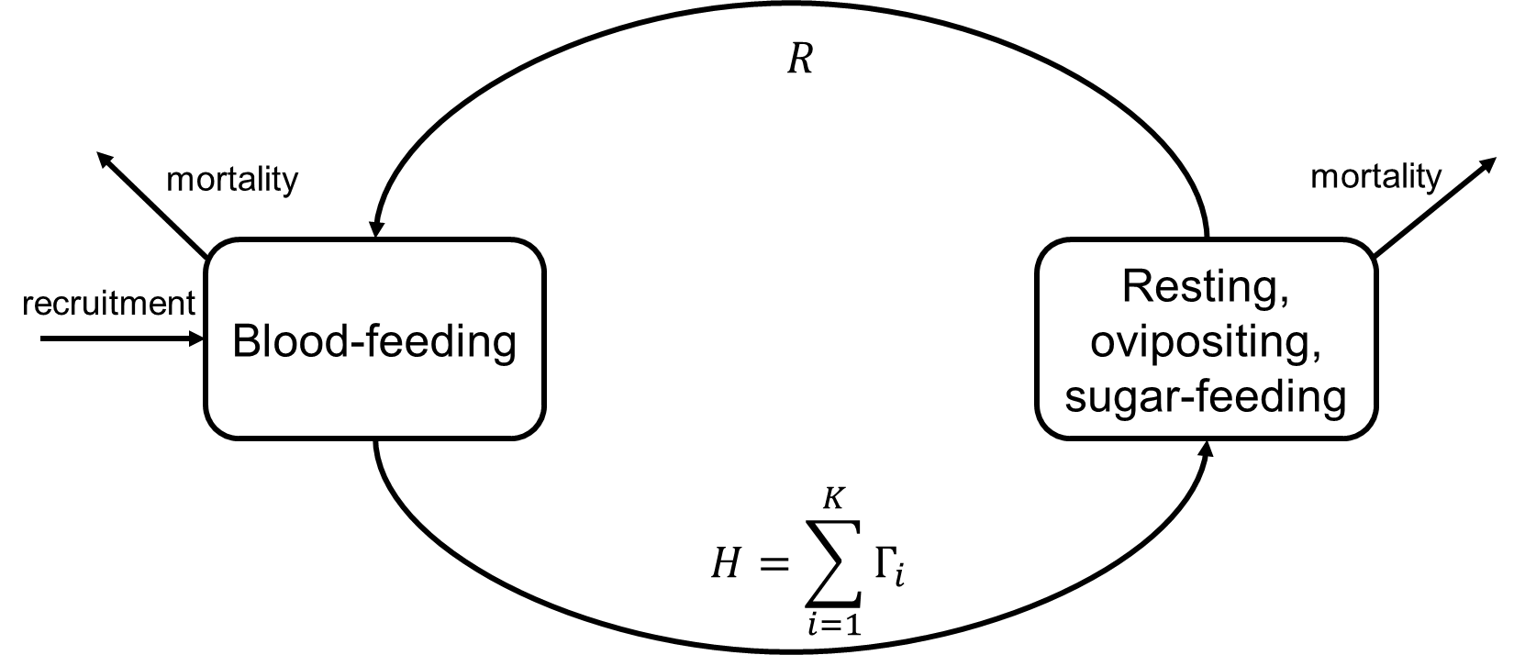
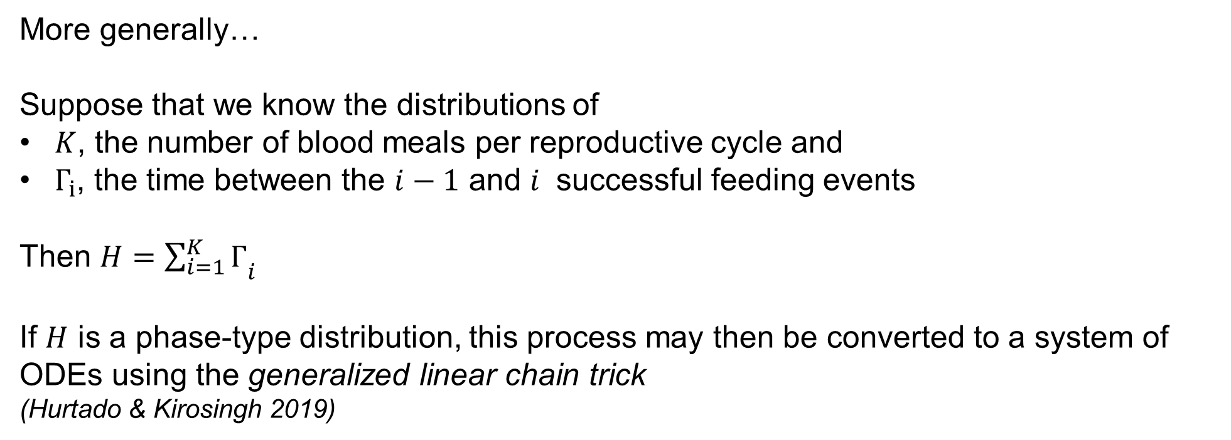
More generally…
Suppose that we know the distributions of
$K$, the number of blood meals per reproductive cycle and
$Γ_{i}$, the time between the $i−1$ and $i$ successful feeding events
Then $H={\sum_{i=1}^{K}{Γ}}_{i}$
If $H$ is a phase-type distribution, this process may then be converted to a system of ODEs using the generalized linear chain trick
(Hurtado & Kirosingh 2019)

Slide 14
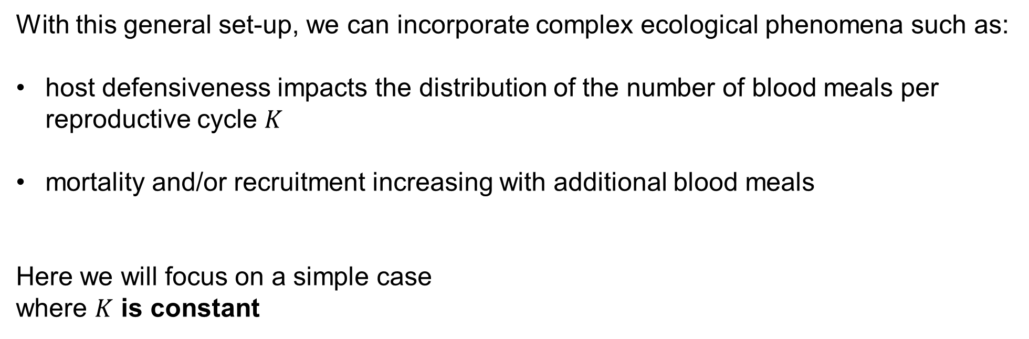
With this general set-up, we can incorporate complex ecological phenomena such as:
host defensiveness impacts the distribution of the number of blood meals per reproductive cycle $K$
mortality and/or recruitment increasing with additional blood meals
Here we will focus on a simple case
where $K$ is constant

Slide 15
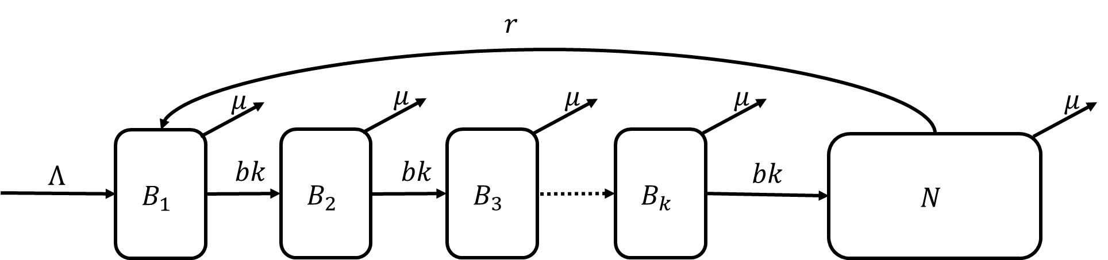
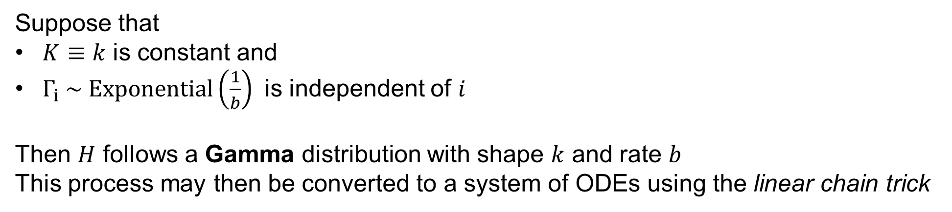
Suppose that
$K≡k$ is constant and
$Γ_{i} \sim \text{Exponential}\left(\frac{1}{b}\right)$ is independent of $i$
Then $H$ follows a Gamma distribution with shape $k$ and rate $b$
This process may then be converted to a system of ODEs using the linear chain trick

Slide 16
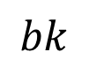
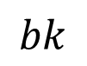
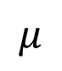
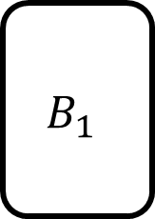

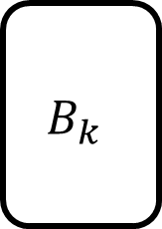
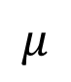
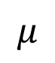
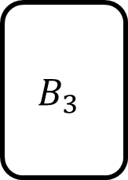
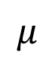
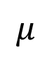
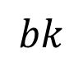
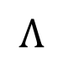

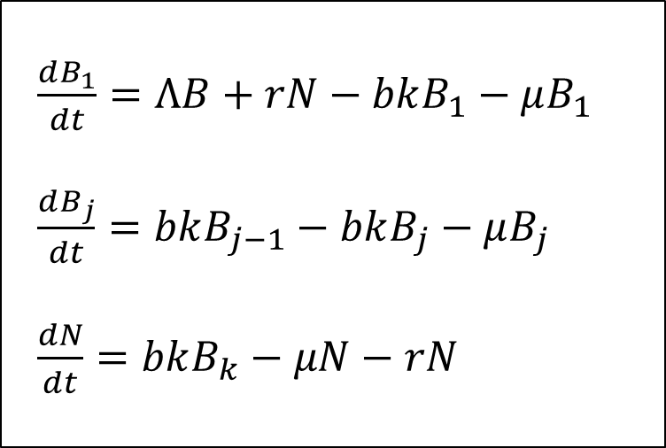
If $H \sim \text{Exponential}\left(\frac{1}{γ}\right)$, then we can use the memoryless property to write this as a simple system of ODEs
$$r$$
$$μ$$
$$μ$$
$$μ$$
$$μ$$
$$μ$$
$$B_{1}$$
$$B_{2}$$
$$B_{3}$$
$$B_{k}$$
$$N$$
$$Λ$$
$$bk$$
$$bk$$
$$bk$$
$\frac{dB_{1}}{dt}=ΛB+rN−bkB_{1}−μB_{1}$
$\frac{dB_{j}}{dt}=bkB_{j−1}−bkB_{j}−μB_{j}$
$\frac{dN}{dt}=bkB_{k}−μN−rN$

Slide 17

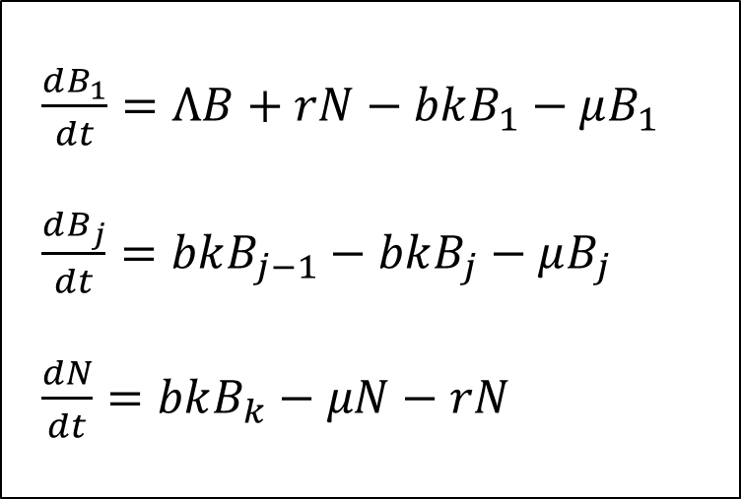
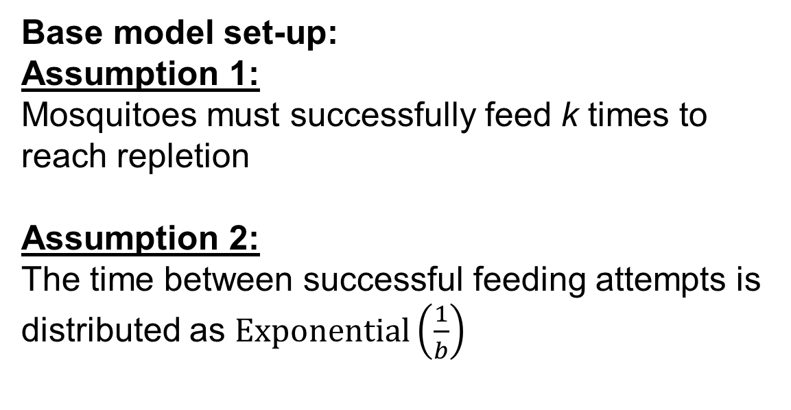
Base model set-up:
Assumption 1:
Mosquitoes must successfully feed k times to reach repletion
Assumption 2:
The time between successful feeding attempts is distributed as $\text{Exponential}\left(\frac{1}{b}\right)$
$\frac{dB_{1}}{dt}=ΛB+rN−bkB_{1}−μB_{1}$
$\frac{dB_{j}}{dt}=bkB_{j−1}−bkB_{j}−μB_{j}$
$\frac{dN}{dt}=bkB_{k}−μN−rN$

Slide 18
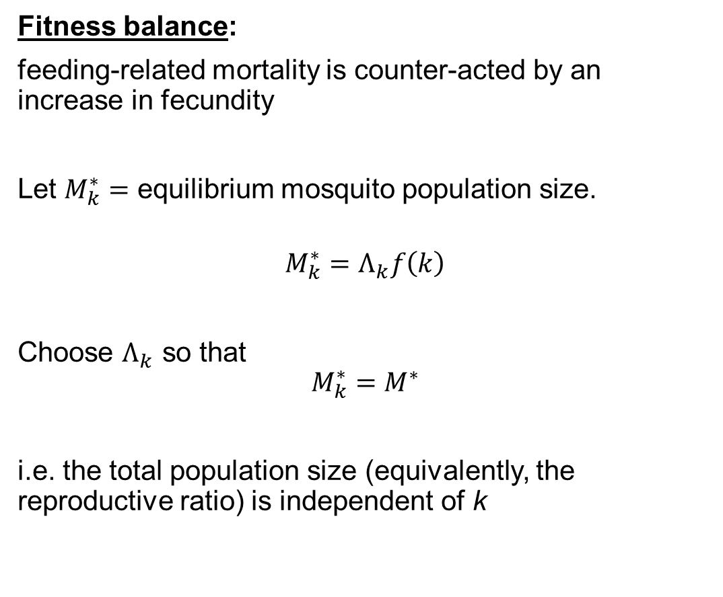
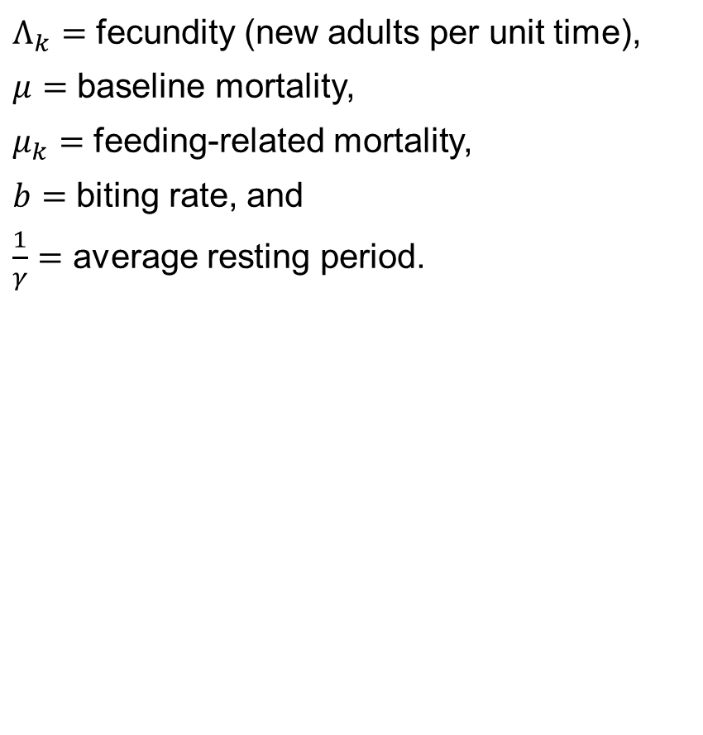
Multiple blood feeding & fitness
$Λ_{k}=$ fecundity (new adults per unit time),
$μ=$ baseline mortality,
$μ_{k}=$ feeding-related mortality,
$b=$ biting rate, and
$\frac{1}{γ}=$ average resting period.
Fitness balance:
feeding-related mortality is counter-acted by an increase in fecundity
Let $M_{k}^{∗}=$ equilibrium mosquito population size.
$$M_{k}^{∗}=Λ_{k}f\left(k\right)$$
Choose $Λ_{k}$ so that
$$M_{k}^{∗}=M^{∗}$$
i.e. the total population size (equivalently, the reproductive ratio) is independent of k

Slide 19
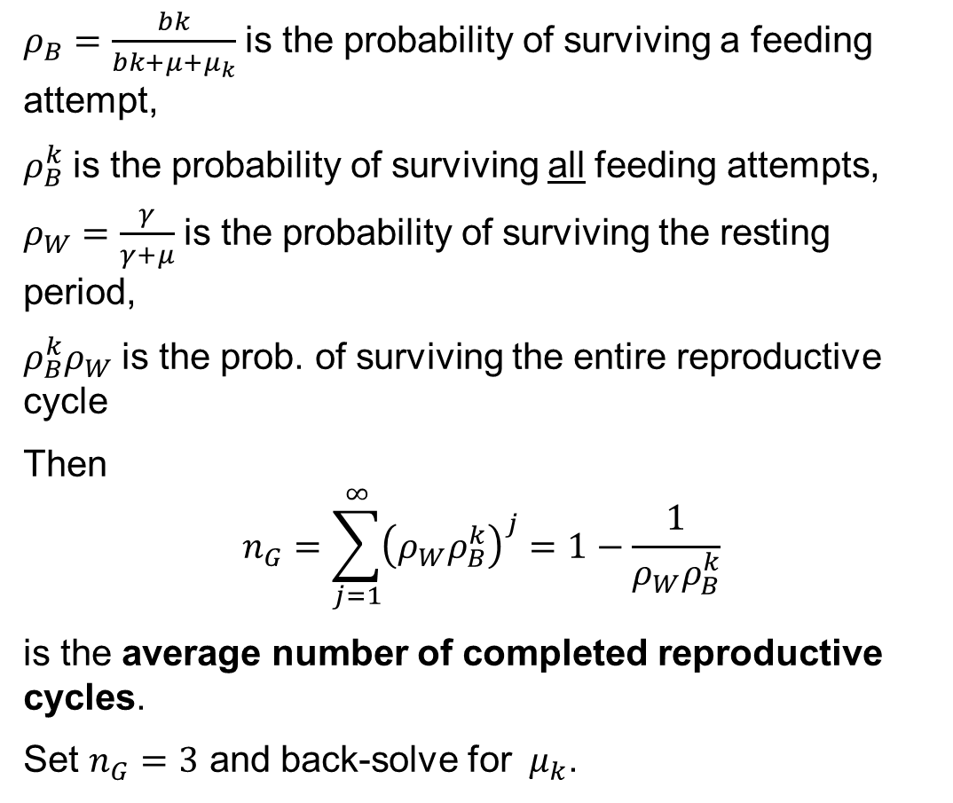
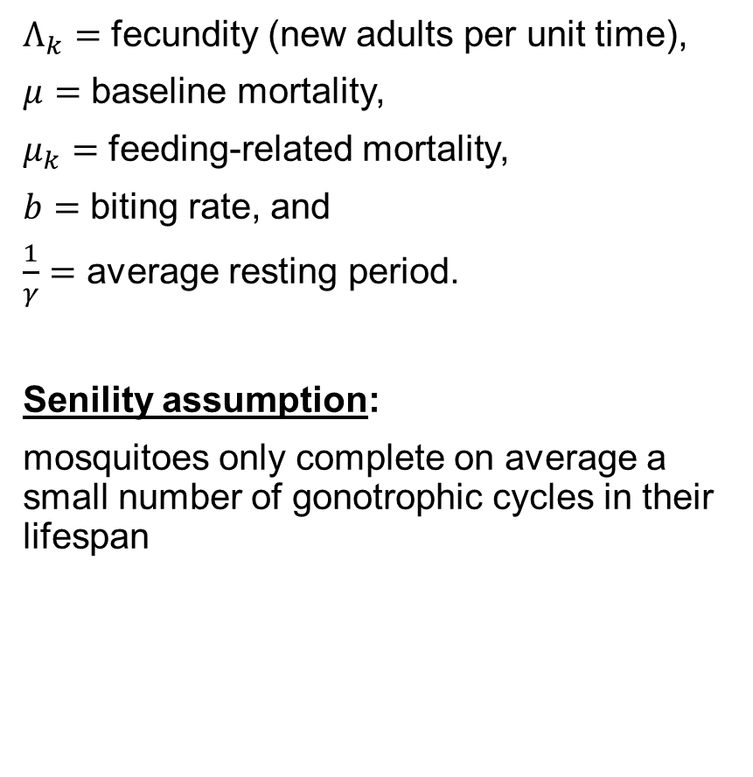
Multiple blood feeding & fitness
$Λ_{k}=$ fecundity (new adults per unit time),
$μ=$ baseline mortality,
$μ_{k}=$ feeding-related mortality,
$b=$ biting rate, and
$\frac{1}{γ}=$ average resting period.
Senility assumption:
mosquitoes only complete on average a small number of gonotrophic cycles in their lifespan
$ρ_{B}=\frac{bk}{bk+μ+μ_{k}}$ is the probability of surviving a feeding attempt,
$ρ_{B}^{k}$ is the probability of surviving all feeding attempts,
$ρ_{W}=\frac{γ}{γ+μ}$ is the probability of surviving the resting period,
$ρ_{B}^{k}ρ_{W}$ is the prob. of surviving the entire reproductive cycle
Then
$$n_{G}=\sum_{j=1}^{∞}{{\left(ρ_{W}ρ_{B}^{k}\right)}^{j}}=1−\frac{1}{ρ_{W}ρ_{B}^{k}}$$
is the average number of completed reproductive cycles.
Set $n_{G}=3$ and back-solve for $μ_{k}$.

Slide 20
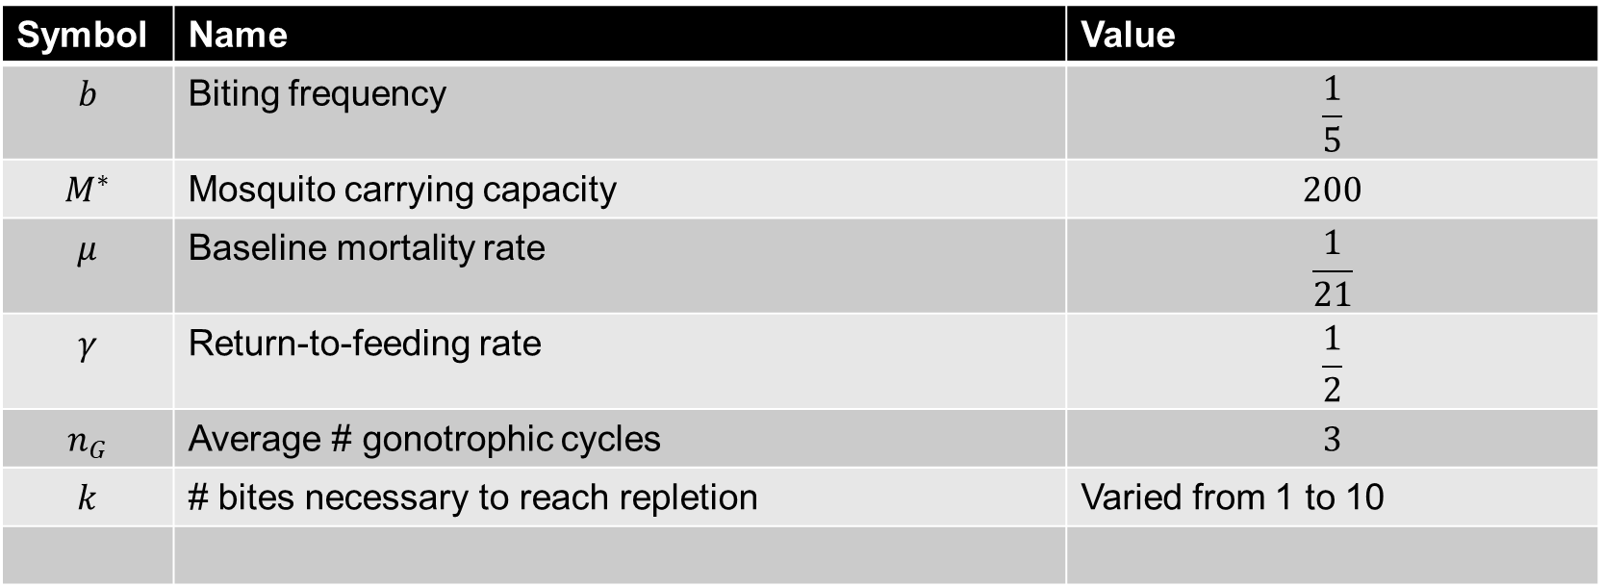
Parameterization
Symbol | Name | Value
$$b$$ | Biting frequency | $$\frac{1}{5}$$
$$M^{∗}$$ | Mosquito carrying capacity | $$200$$
$$μ$$ | Baseline mortality rate | $$\frac{1}{21}$$
$$γ$$ | Return-to-feeding rate | $$\frac{1}{2}$$
$$n_{G}$$ | Average # gonotrophic cycles | $$3$$
$$k$$ | # bites necessary to reach repletion | Varied from 1 to 10

Slide 21
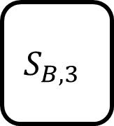
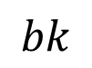
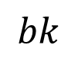
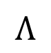
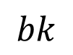
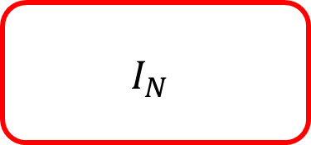
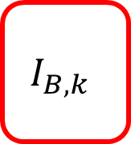
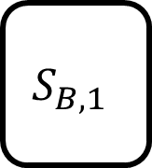
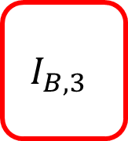








Mosquito-host contact & transmission
Ross-Macdonald force of infection terms
$$Λ$$
$$S_{B,1}$$
$$bk$$
$$S_{B,2}$$
$$bk$$
$$S_{B,3}$$
$$S_{B,k}$$
$$bk$$
$$S_{N}$$
$$I_{B,1}$$
$$bk$$
$$I_{B,2}$$
$$bk$$
$$I_{B,3}$$
$$I_{B,k}$$
$$bk$$
$$I_{N}$$

Slide 22

Mosquito-host contact & transmission

Slide 23


Forces of infection
Following the Ross-Macdonald formulation:
$$F_{M→H}=\left(\sum_{j=1}^{k}{β_{MH,k}}\frac{I_{B,j}}{N_{M}}\right)bk\frac{N_{M}}{N_{H}}S_{H}$$
$$F_{H→B_{j}}=β_{HM,k}bk\frac{I_{H}}{N_{H}}bkS_{B,j}$$

Slide 24

Transmission probability and multiple-blood feeding
Perhaps mosquitoes that bite more frequently take smaller blood meals
The per-encounter probability of transmission to or from mosquitoes may be reduced
Not always the case: some viruses like Dengue can be transmitted before a mosquito even begins ingesting blood
Simplest assumption: reduction is proportional to the increase in biting frequency
$$β_{MH,k}=\frac{β_{MH}}{k}$$
$$β_{HM,k}=\frac{β_{HM}}{k}$$

Slide 25
To understand how k affects transmission potential and population ecology consider:
Case 1: all parameters independent of k
Case 2: only mortality & fecundity depend on k
Case 3: only transmission parameters depends on k
Case 4: mortality, fecundity, and transmission parameters all depend on k

Slide 26

Mosquito population structure

Slide 27

Basic reproduction number (R₀) and k

Slide 28

R₀ : transmission prob. independent of k

Slide 29

R₀: transmission varies with k

Slide 30
R₀ and k again

Slide 31
Summary

Slide 32
Next steps

Slide 33

Thank you!
Contact info:
kyle.dahlin@uga.edu

